Slide 1
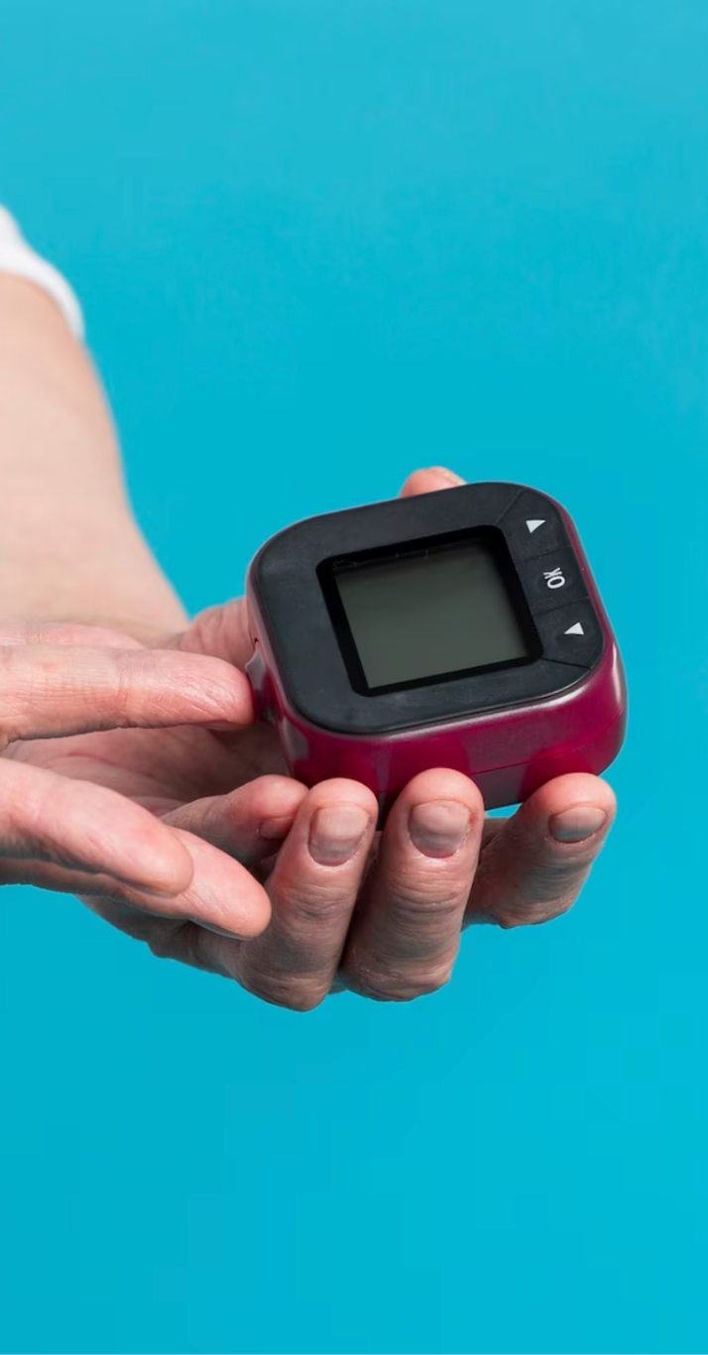
Diabetes NLP Analysis
Group 21: Jacqueline Yang, Jiayin Lin, Shuran Yang (alphabetical order)
Mentor: Anupam Singh
TA: Henry Yeom
Notes:
JY natural language text data of consumer posts, comments and replies on Diabetes

Slide 2

Introduction to the disease
Diabetes is a chronic disease that affects how the body processes blood sugar (glucose).
There are three main types: Type 1, Type 2, and Gestational diabetes.
Insulin, a hormone produced by the pancreas, plays a key role in regulating blood sugar.
Uncontrolled diabetes can lead to:
Cardiovascular disease (heart attack, stroke)
Nerve damage (neuropathy)
Kidney failure (nephropathy)
Vision problems or blindness (retinopathy)
Increased risk of infections
Notes:
SY

Slide 3
537 Million
10.5%
37%
Are living with diabetes (2021). Estimated to rise to 783 million by 2045.
Of the population in U.S. have diabetes.
May have prediabetes.
Notes:
JL
All talking about Adults

Slide 4
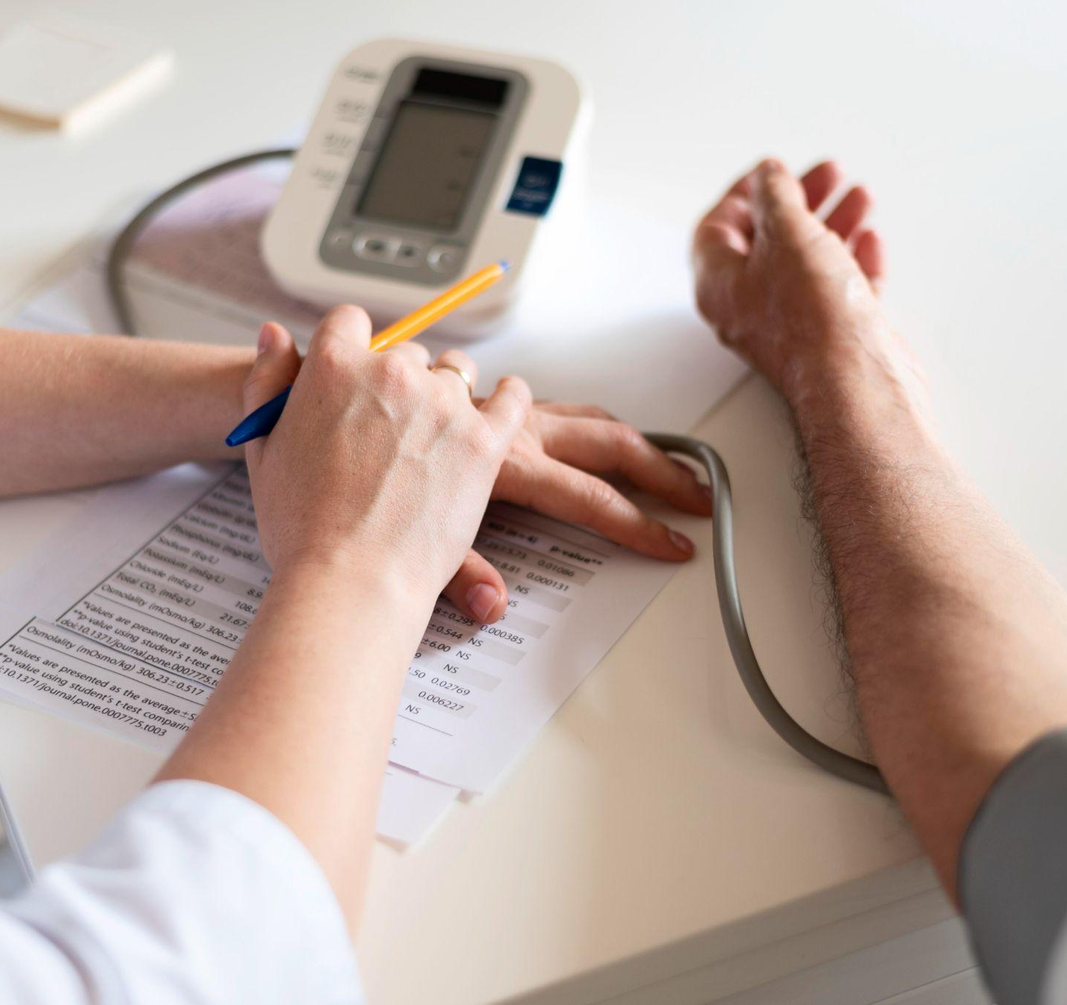

Likelihood of developing it:
Type 1 Diabetes:
Autoimmune condition; typically develops in childhood or adolescence.
Less common, accounting for about 5-10% of diabetes cases.
Type 2 Diabetes:
Primarily influenced by lifestyle factors (e.g., obesity, inactivity).
Risk factors include family history, age, and ethnicity.
Makes up approximately 90-95% of diabetes cases.
Gestational Diabetes:
Temporary condition during pregnancy, often resolved postpartum.
Increases the mother’s and child’s risk of Type 2 diabetes later.

Slide 5
Data Preprocessing flowchart
4 Reddit datasets and 1 non-reddit dataset
Data Exploration
Ask Questions
Data Cleaning
One-hot-encoding
Explore the data, understand it, and plan how to clean it:
Describe data information, statistical summary, data type, null or non-null counts
Read documentation, understand columns
Understand granularity and time of datasets:
How is the data collected
When is the data collected
What time range and social media are covered
Drop null columns, identify outliers, drop outliers, combine the 4 reddit datasets, and generate cleaned data.
For columns like sound-bite-text: it is the main text data we will perform NLP. For numerical columns like richness, subscriber, followers, reddit karma, we will analyze the distribution and categorize them.
Ready for topic modeling, keyword analysis, and visualization

Slide 6
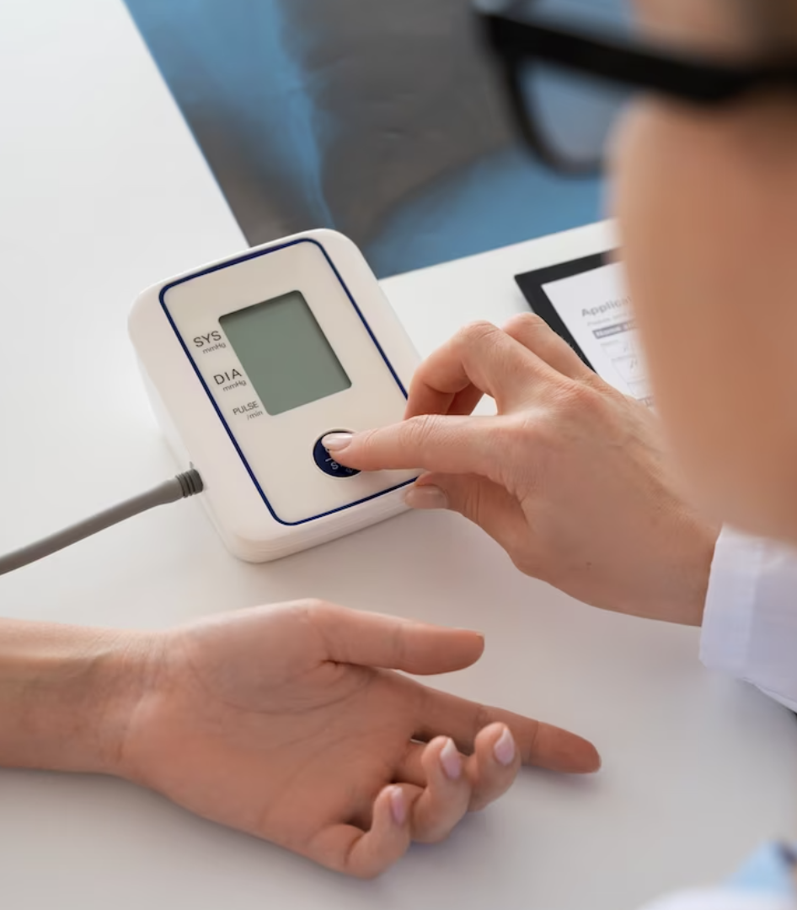
01.
Understanding the Disease

Slide 7
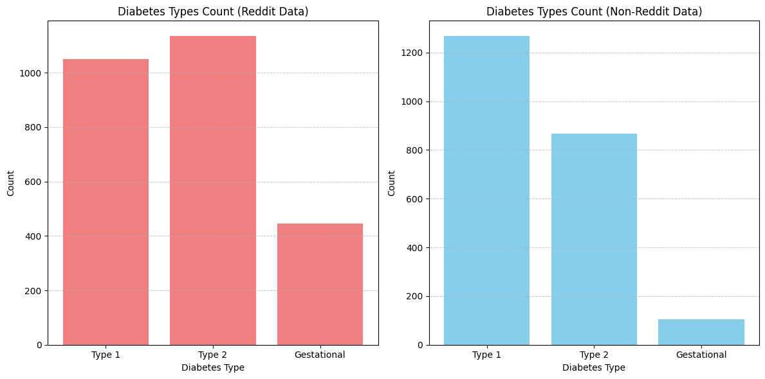
Diabetes Type Prevalence
In the Reddit dataset, Type 1 and Type 2 diabetes counts are relatively close, with Gestational diabetes significantly lower.
In the non-Reddit dataset, Type 1 diabetes is slightly more prevalent than in Reddit.
Both dataset show a significant high prevalence of Type 1 Diabetes, which indicate the high engagement and concern of Type 1 Patients or caregivers.
Notes:
Non-Reddit sources might capture a broader audience, including more casual mentions or reports.
The higher count of Type 2 diabetes discussions in the Reddit dataset could indicate that people with Type 2 diabetes or their caregivers are more active in community discussions, possibly due to the lifestyle-related nature of Type 2 diabetes

Slide 8
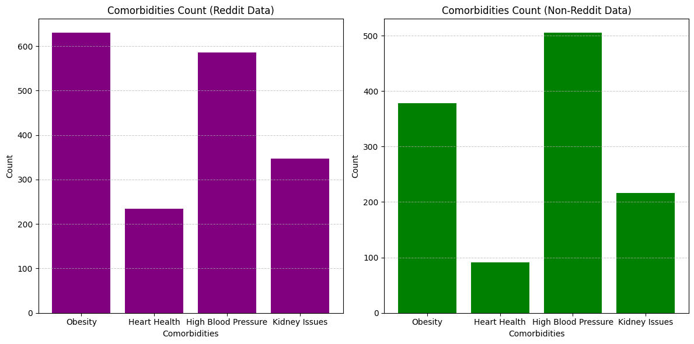
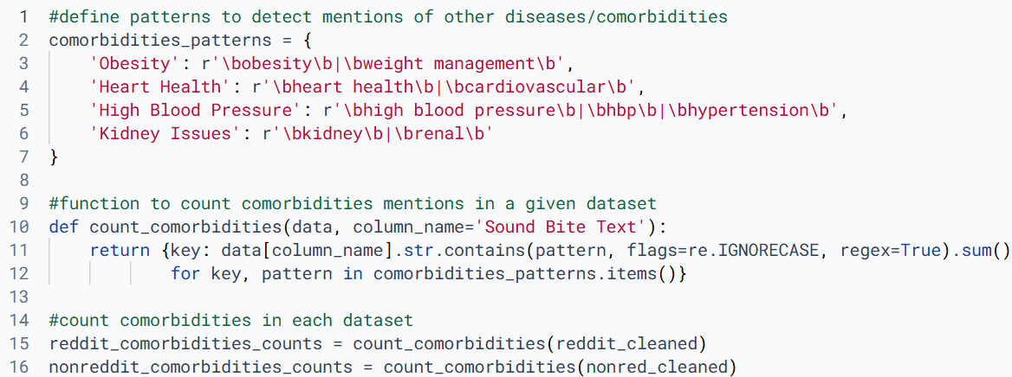
Comorbidities Count
In both datasets, Obesity and High Blood Pressure are the most frequently mentioned comorbidities.
Kidney Issues are especially significant in the Reddit dataset, showing relatively high engagement compared to Non-Reddit sources.
The significantly higher mentions of Obesity in the Reddit dataset suggest an opportunity to target obesity-related interventions in these forums.
Notes:
Heart Health and Kidney Issues are less frequently mentioned compared to Obesity and High Blood Pressure, but still present a noticeable concern. Kidney Issues are especially significant in the Reddit dataset, showing relatively high engagement compared to Non-Reddit sources.

Slide 9
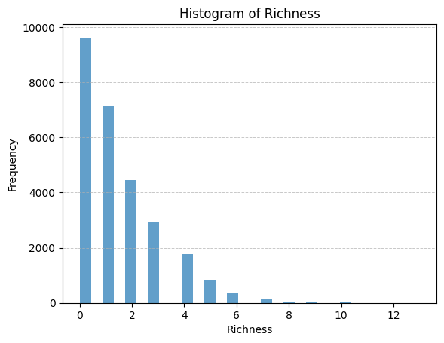
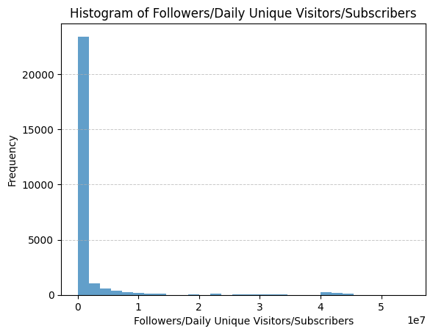
User Classification
Insights
The histograms help define the appropriate thresholds for binning. For example:
"Richness" bins:
Low: 0–2
Medium: 2–5
High: 5+
"Followers" bins:
Low: 0–10k
Medium: 10k–100k
High: 100k+
Next step: Use these thresholds to segment the data. Right-skewed data may require more bins for lower values and fewer for higher values to capture nuances.

Slide 10
02.
Keyword and Sentiment

Slide 11
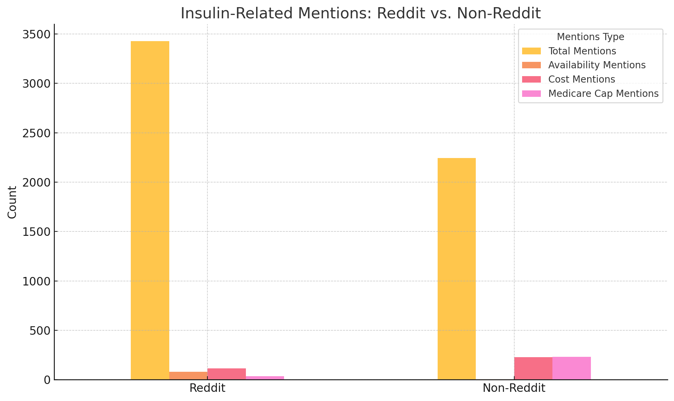
Insights on Insulin Discussions
In Reddit discussions, there are 3,430 mentions of insulin, with:
80 mentions focusing on availability,
116 mentions discussing costs, and
36 mentions referencing Medicare caps.
In Non-Reddit sources, there are 2,246 mentions of insulin, with:
Only 3 mentions about availability,
227 mentions addressing costs, and
233 mentions discussing Medicare caps.
Notes:
This indicates that Reddit users are more likely to highlight insulin availability, potentially reflecting personal frustrations or community concerns. Meanwhile, Non-Reddit sources focus heavily on costs and Medicare caps, possibly aligning with more formal or policy-driven discussions.

Slide 12
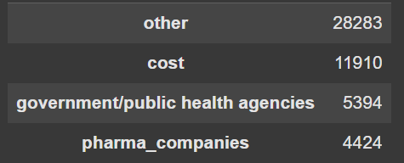
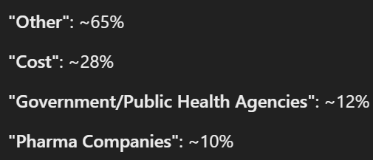
No Reddit Topic Modeling
Key Insight:
11,910 out of ~30k posts mention cost-related terms.
5,394 posts discuss government or public health agencies. Selected topic key words: "biden", "president", "policy", "public", "covid"
4,424 posts reference pharmaceutical companies.
High "Other" Count: Model might need more topics to capture diverse themes. For example:
Increase n_components in LDA (e.g., from 5 to 10 or 15).
Add subcategories (e.g., "mental health" or "diet and exercise").
Notes:
Brief Explanation of LDA
Latent Dirichlet Allocation (LDA) is a topic modeling technique used to uncover hidden topics in a collection of text documents. It works by grouping words that frequently occur together into topics.
What Does LDA Do?
LDA assumes that each document (e.g., a Reddit post) is a mix of multiple topics.
Each topic is represented by a distribution of keywords (e.g., "cost," "price," "insulin" for a healthcare-related topic).

Slide 13
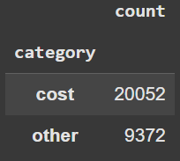
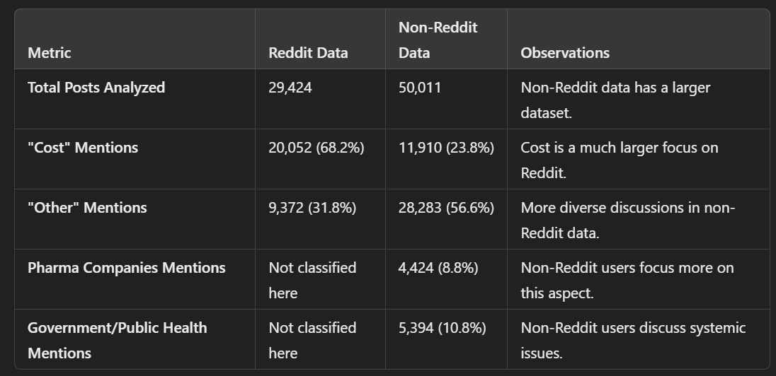
Reddit Topic Modeling
Comparison
Notes:
Key Insights from the Reddit Data
Category: "Cost"
The majority of discussions (20,052 posts) focus on cost-related topics such as the affordability of treatments, insulin pricing, and financial burden.
This indicates that cost is a dominant concern for Reddit users discussing diabetes.
Category: "Other"
9,372 posts fall under "other," which suggests that many discussions address topics not captured by the predefined categories (e.g., personal experiences, diet, mental health, or general lifestyle discussions).

Slide 14
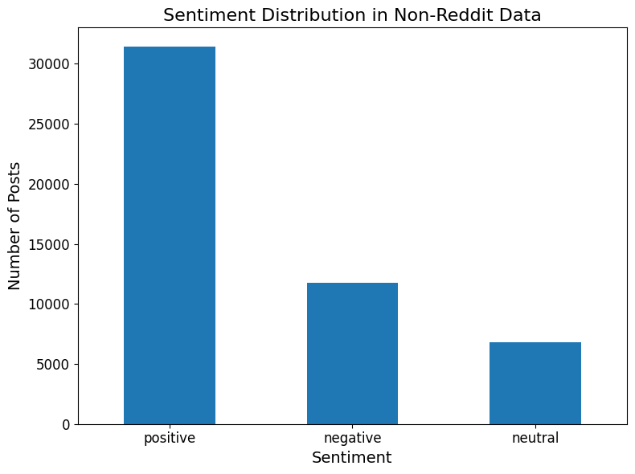
Notes:
Analyze the sentiment of a given text using TextBlob.
Returns polarity and subjectivity scores.

Slide 15
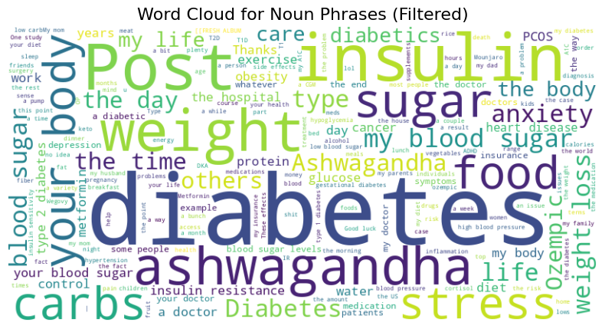
Notes:
Body, weight, insulin, sugar
Insulin resistance, exercisee,
Worries: anxiety, cancer, obesity
Ashwagandha: a herb. Also need unify the upper-lower cases in the next step.

Slide 16
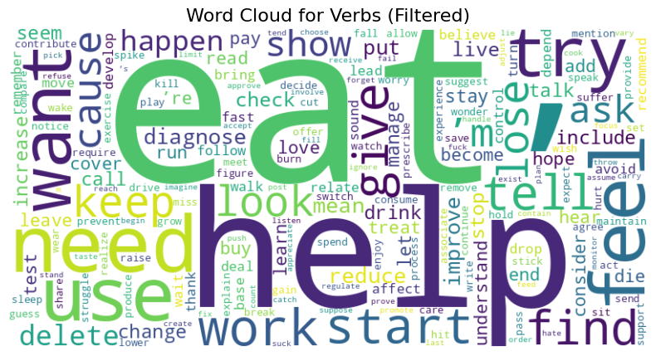

Slide 17
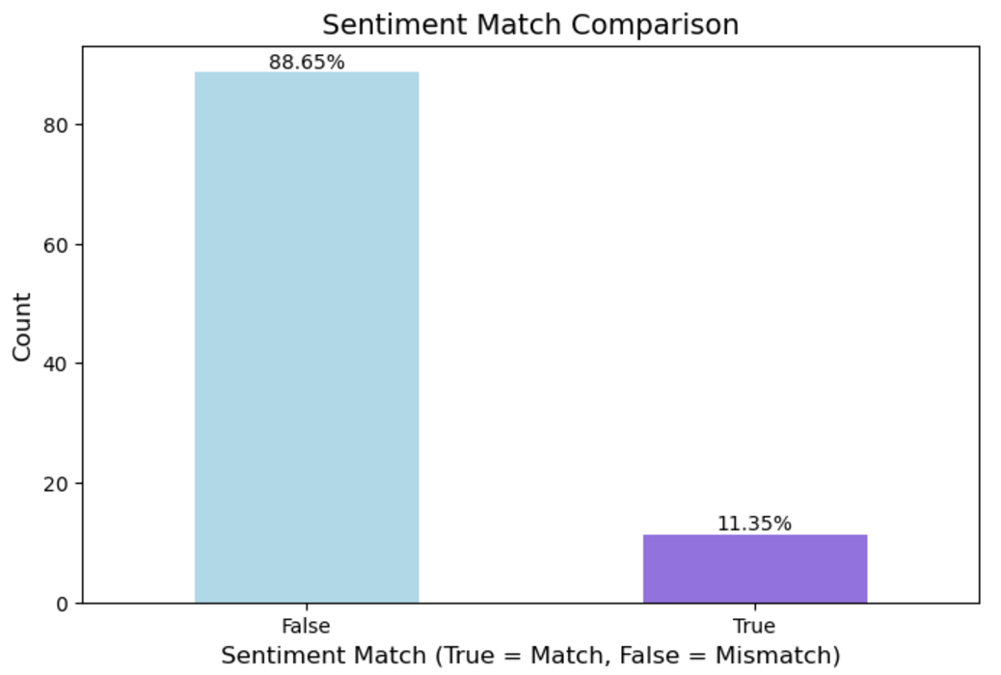
Sentiment Match Comparison:
LLM vs Original
The chart shows two categories:
False: Instances where the sentiment predicted by the LLM does not match the original sentiment.
True: Instances where the sentiment matches.
Approximately 88.65% of the predictions do not match the original sentiment.
Only 11.35% of the predictions match.
The LLM predictions have a high rate of difference compared to the original sentiment. We need to investigate it further to see if LLM sentiment is actually an improvement or mismatch.
Notes:
we randomly chose a sample of 2539 rows, because each open ai api call needs money

Slide 18
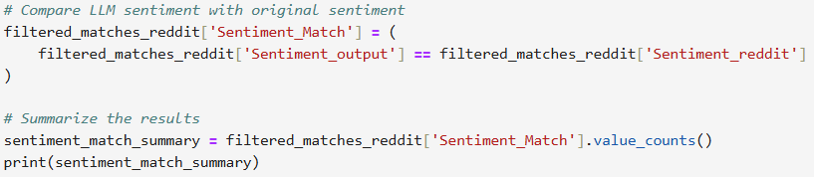
Example #1
Original sentiment from the data says negative, probably due to words like ‘more difficult’, ‘die’.
However, LLM (OpenAI gpt4o) identifies it to be unknown sentiment, which makes more sense.
Conclusion, LLM can take subjectivity into account, and judge a paragraph by its context.
Many NLP models ‘tokenize’ by words, which break the context and may lead to low accuracy.
Notes:
Example of a post someone made that seems to be in response to a newspaper or article of some sort. The person is having a hard time managing their diabetes and autoimmune disease, and mentions the amount of medication that they’re taking.

Slide 19
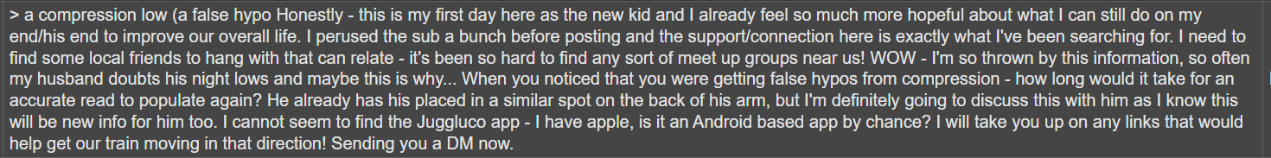
Example #2
Original sentiment from the data says neutral.
LLM (OpenAI gpt4o) identifies it to be positive sentiment, which makes more sense.
Original sentiment from the data says mixed.
LLM (OpenAI gpt4o) identifies it to be negative sentiment, both makes sense.

Slide 20
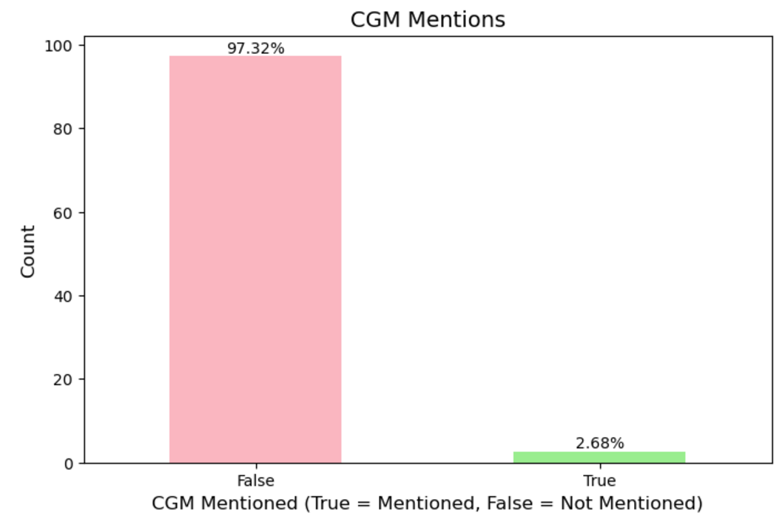
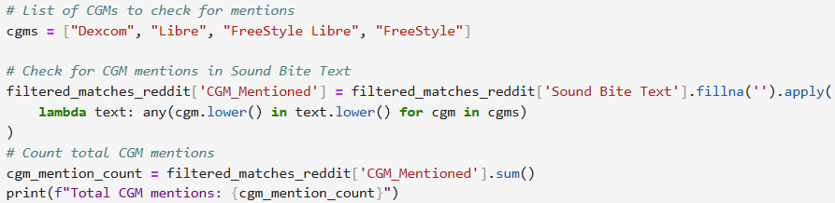
CGM Mentions
The chart shows two categories:
False: Instances where CGMs (e.g., Dexcom, Libre, etc.) are not mentioned in the Sound Bite Text.
True: Instances where CGMs are mentioned.
Approximately 97.32% of the rows do not contain CGM mentions.
Only 2.68% of the rows mention CGMs.
CGMs are rarely mentioned in the data, indicating a possible underrepresentation of CGM-related discussions.
If we wanted to focus on CGM-related content, this could indicate a need to refine the dataset or the filters used to extract relevant content.

Slide 21
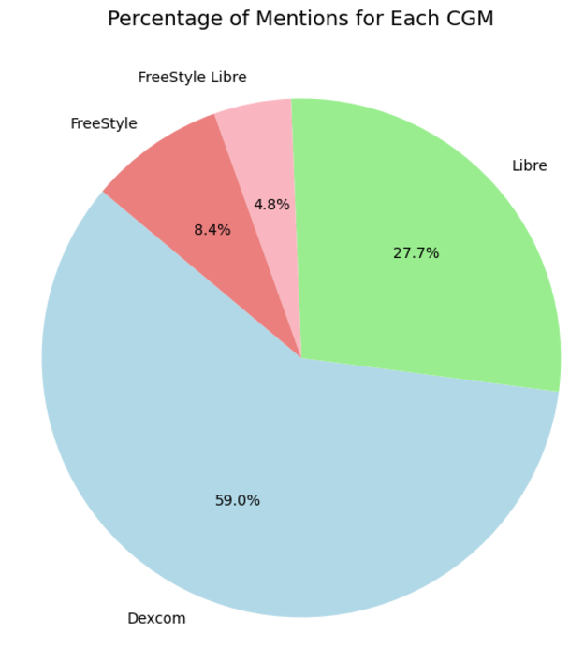
CGM Brand Breakdown
59.0% of the mentions are about Dexcom. This indicates that Dexcom is the most discussed CGM in the dataset.
Possible reasons:
Greater market presence or popularity.
Users frequently sharing their experiences (positive or negative) with Dexcom.
27.7% of the mentions are about Libre (including FreeStyle Libre). Libre is the second most discussed CGM.
Abbott's Libre devices are widely used due to their affordability and simplicity compared to Dexcom, which might explain its significant share of mentions.
8.4% are about FreeStyle (likely older models or non-CGM products by Abbott).
4.8% are about FreeStyle Libre specifically.
FreeStyle Libre is a CGM brand by Abbott, so its lower percentage compared to Dexcom could indicate less awareness or user adoption in this dataset.

Slide 22
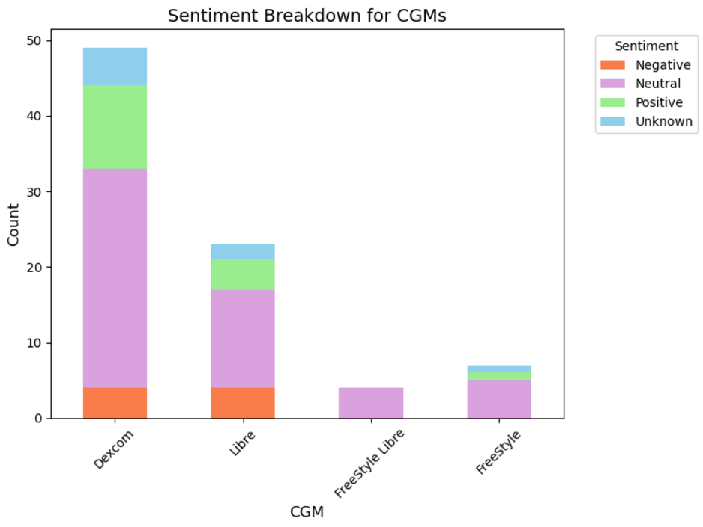
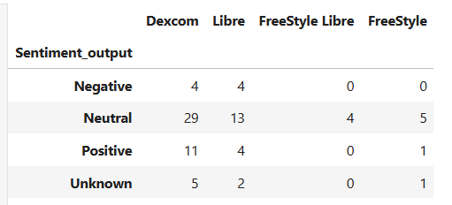
Sentiment Breakdown for CGMS
Dexcom leads in mentions and has a relatively higher proportion of Positive and Neutral sentiment.
Libre follows Dexcom but has fewer Positive mentions, indicating less user satisfaction overall.
FreeStyle Libre and FreeStyle have limited mentions and minimal sentiment variation, suggesting lower engagement or usage in the dataset.

Slide 23
Thank You!
Notes:
Future steps
limitations , technical issues
Only compared data but didn’t convert to percentages, y axis are not different and make it harder for people to read it
For user classification section we Wanted to segment users based on clasiffiation but didn’t avhe chance to do it
Tried LLM but didn’t have chance to use it on the whole data and also it cost money to use, but in the future we would like to expand our analysis to the whole dataset

